Slide 1
TARSAN API
Presenter: Gunarto Sindoro Njoo (532711)

Slide 2
Overall Architecture
Client
TARSAN
Proxy mode
Proxy Server
ICAP Server
Browser Extension
Proxy authentication requests
Query using JSON params
Database
REST API Server
Notes:
Client has 2 options to connect to Tarsan: Proxy mode or Browser extension
Squid need to be configured to connect with ICAP server
ICAP Server could be in the same server with Squid or in different host
Both ICAP Server and Browser extension connect to Rest API Server using JSON params

Slide 3
Proxy Mode
Provide access to the server using an authentication via Browser
Pros:
Plug-and-Play on user’s perspective
Cons:
Couldn’t provide HTTPS service
Flow process:
Proxy authentication on the browser
When user access any HTTP website, user’s requests and responses are passed through ICAP Server
After ICAP Server processes the data, it sends back to the Proxy
Proxy sends the (modified) content to the client

Slide 4
Browsing in the Internet
Requests
Internet
Client
Responses
Proxy mode
Proxy Server
ICAP Server
Database
REST API Server
Notes:
Direct connection from client to the internet

Slide 5
Browsing in the Internet (using Proxy)
Internet
Client
Requests
Requests to Proxy
Responses from Proxy
Proxy mode
Proxy Server
Responses
ICAP Server
Database
REST API Server
Notes:
Browsing behavior of using proxy server

Slide 6
Browsing in the Internet (using ICAP)
Internet
Client
Requests
Requests to Proxy
Responses from Proxy
Proxy mode
Responses
Proxy Server
ICAP Server
Content adaptation
Query using JSON params
Database
REST API Server
Notes:
Client has 2 options to connect to Tarsan: Proxy mode or Browser extension
Squid need to be configured to connect with ICAP server
ICAP Server could be in the same server with Squid or in different host
Both ICAP Server and Browser extension connect to Rest API Server using JSON params

Slide 7
ICAP
Internet Content Adaptation Protocol
Used to extend transparent proxy server (e.g., Squid)
Generally used for virus scanning, content filter, translation, adding ads, etc.
Pros:
Proxy-independent
Scalable
No Squid modifications
Supports remote adaptation servers
Cons:
Communication delays
Needs a stand-alone ICAP server (Process or Host)
Protocol functionality limitations

Slide 8
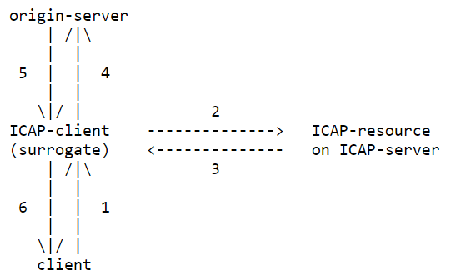
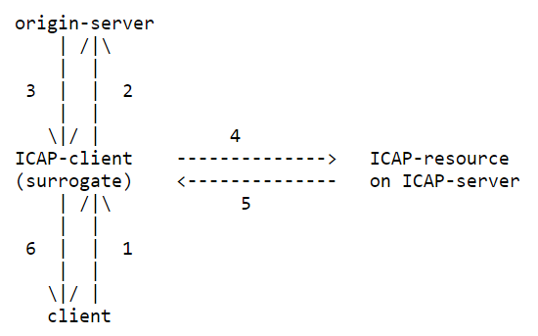
ICAP Request-Response Process
ICAP Request Process
ICAP Response Process
Modify the request to the Internet
Modify the response from the Internet
Thus, we could insert ads here!

Slide 9
REST API
REST (Representational State Transfer) architecture for scalable web services over HTTP
Use JSON to communicate over HTTP requests
Provide various functions:
USER LOGIN
USER REGISTRATION
LOG USER EVENT
RETRIEVE ADS URL
CREATE PATTERN
GENERATE PATTERN LIST
CREATE ADS
ADS CLICK HANDLER

Slide 10
Implementation Details
Proxy Server: Squid 3.5.6
ICAP Server: Greasyspoon 1.0.10 (Java)
Rest API Server: Java EE (JDK 8) + Hibernate
Database: PostgreSQL

Slide 11
Demo
REST API IP: 140.96.29.153
ICAP Server API: 140.96.29.58 backup on: 192.168.56.101 (on 140.96.29.240)
SSH: root, password
Proxy Server
IP: 140.96.29.58
Port: 3128
User: lalala
Password: lalala
Test cases: http://notes.io/qhND

